Slide 1
Software Project Management
Dr. Md. Nasim Adnan

Slide 2
Before You Start: Assessing Value and Risks
Projects create new products, new services, or new capabilities. The first step of a sound management process is to understand whether the new products, services, or capabilities are worth our effort.
The relevance of a project depends, in general, upon two main factors:
The value generated by the project
The risks associated with the project

Slide 3
Project Value: Aspects to Consider
Three main factors determine the value generated by a project:
Direct and indirect value. As mentioned earlier, the value of a project does not refer necessarily and only to the revenues it generates directly and through its outputs. Considerations relative to the social and environmental impact, image and publicity, entering a new market, and know-how acquired are some of the considerations that could add or subtract value from a project.
Sustainability. Many IT projects start without an idea or a strategy to sustain their outputs. Thus, the outputs of a project might not live long after a project and its resources end. Taking into account the operational costs of a project’s outputs and the way in which the project outputs will survive after a project ends is an important consideration to understand whether a project is worth doing. (apps…)

Slide 4
Alignment with the strategic objectives of the organization. Ensuring that the project aligns with the goals of an organization is an essential point to consider before a project is worth starting. Alignment with the strategic objectives can determine the priority of a project.

Slide 5
Project Risks: Aspects to Consider
Various factors determine the risk profile of a project. Among them are:
Resource availability. Projects require the availability of resources—human, financial, and technical—in specific time frames.
Timing. Many projects have specific time windows for the delivery of their outputs. Deliver too early or too late and the outputs of the project might be useless. Consider, for instance, a project to build a rocket to reach another planet. The actual launch can occur only on a specific time frame, to take advantage of the relative position of planets. (sling shot)
Technical difficulty or uncertainty. The success of many projects relies on the actual capability of solving various technical challenges.

Slide 6
Project environment and constraints. Projects are influenced by various constraints, both internal and external. Various internal and external stakeholders will have an interest in positively or negatively influencing a project. Regulations and standards can severely limit what can be done on a project.

Slide 7
Techniques to Assess Value and Risks: Financial Methods
Payback: The simplest financial evaluation is the payback method, which measures how long it will take to return a project’s investment. When using the payback method, an estimation of the project expenses and incomes determines the profits and losses at the end of each project year. The payback is the year at which the project covers all expenses and starts earning. The shorter the payback, the better.
Return of Investment: To overcome some of the limitations of the payback method, another technique that is often employed is the return of investment (ROI), which measures how much we get back for each dollar invested. ROI is calculated from the annual profit, defined as the average profit per year and computed by dividing the profit by the duration of a project:

Slide 8
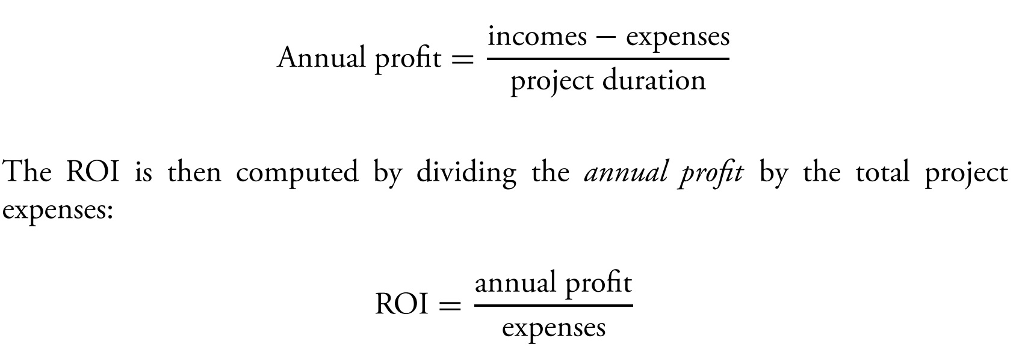

Slide 9
Net Present Value and Internal Rate of Return: Payback and ROI do not take into account the effects of inflation, namely, the fact that an amount of money in the future has a lower value than the same amount available now.
The net present value technique (or NPR for short) overcomes this issue by taking into account the inflation rate. Thus, if a reliable estimation of the inflation rate can be provided, the value of future expenses and incomes for a project can be recomputed in terms of their actual value.
In particular, when using NPR, profit and losses are computed using the following formula:

Slide 10
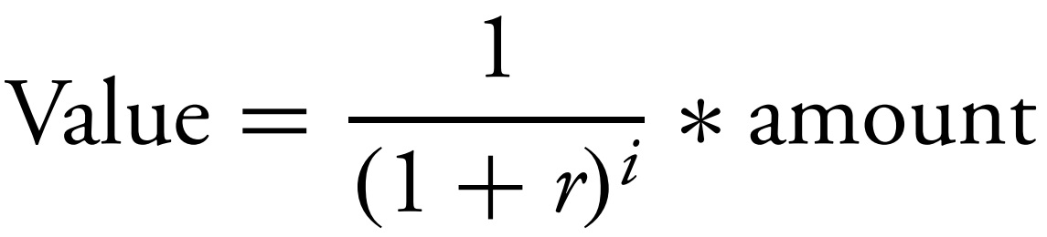
Where r is the inflation rate, amount is the net profit at year i, and value is the current value of amount. Note that the first project year is year 0.

Slide 11
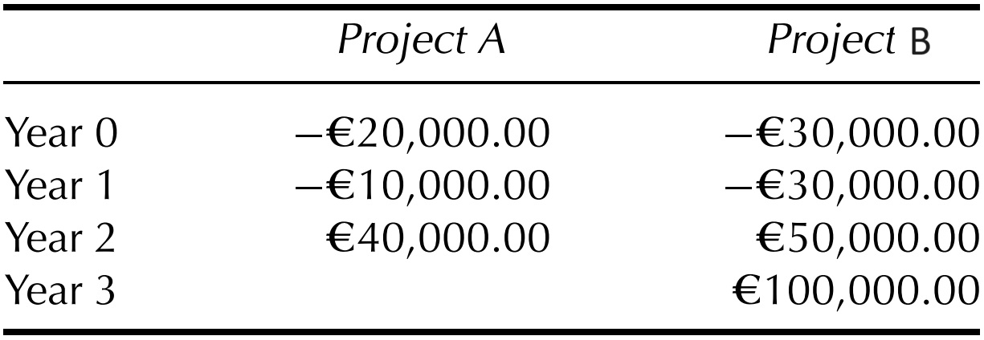
Applying Financial Methods: An Example

Slide 12
If we use the payback method, we select Project A, since it has a shorter payback period. In fact, year 0 is forecast to end with losses, for Project A. So will year 1. At the end of year 2, however, the financial statement will show earnings of EUR 10, 000.

Slide 13
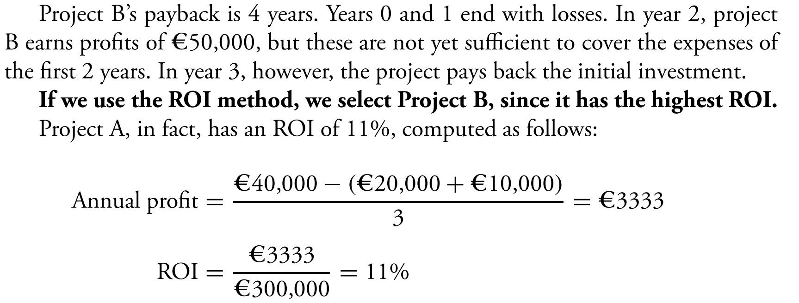

Slide 14
Score Matrices
Financial methods help determine the financial viability of a project, but tell nothing about the project characteristics that are not measurable with profits and losses.
Therefore, other methods have been proposed to assess a project.
One of the simplest is the score matrix, which allows one to measure a project along several dimensions and assign it a value.
A score matrix is a list of project criteria, each of which is assigned a weight, which measures the importance the criteria for the organization we work for.

Slide 15
When we evaluate a project using a score matrix, we measure how well the project satisfies each criterion, by assigning a number from 1 (very low) to 5 (very high).
We then multiply the scores with the weights and sum all values. Projects scoring a higher value are more desirable than projects with a lower score.
Projects can also be compared side by side; hence, the use of the term “matrix” in the name of the technique.

Slide 16
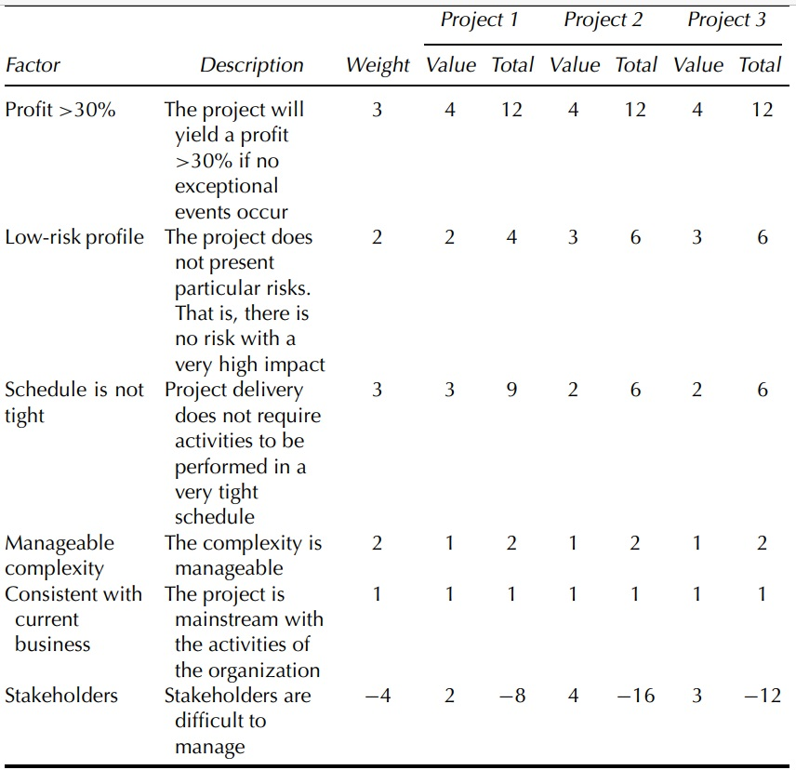

Slide 17
Stakeholder Analysis
Stakeholders can exert quite a lot of influence on a project and determine the success or failure of a project.
Understanding how stakeholders can influence (positively or negatively) a project, is good practice to assess the project’s chances of success and to define a stakeholder management policy.
Various ways have been proposed to classify stakeholders. In general, stakeholders are classified in two dimensions:
The power they can exert in the project
The interest they have in the project

Slide 18
Assessing Sustainability
Evaluating the operational cost of a project outputs helps assess the long-term benefits of a project and what additional actions a project should include to ensure that its results will live after the project ends.
This analysis is relevant in several high risk or highly constrained projects, such as projects to start new companies, research projects, and projects to foster economic development.
Often, in fact, these projects deliver benefits as long as steady financing is available; little or nothing survives when the project ends.

Slide 19
The Project Feasibility Document
The project feasibility document closes the assessment phase by describing the main characteristics of a project and by analyzing, using techniques presented earlier, the value and risks of a project.
The document can be used to formally authorize the start of a project.
Thus, a feasibility document contains at least the following information:
A statement of work, which describes the scope of the project
The business objectives of the project -> impact of its outputs
A summary of the project budget, which forecasts expenses and incomes

Slide 20
A summary of the project milestones, which is a rough schedule of the project identifying the most important events
An analysis of the stakeholders
The project risks
Possible alternatives to the project, such as a make-or-buy decision
An evaluation of the project and alternatives, using the techniques described above

Slide 21
Formalizing process…
After assessing Value and Risks, one of the first activities is fixing and having stakeholders agree on the project scope.
This, in fact, constitutes the basis for any further management activity, namely, the definition of the work to be performed, schedule and budget, and the skills required by the team that will perform the work.
Project goals, together with the schedule and the budget, are also the basis for contractual agreements with the clients.

Slide 22
Deciding the Work
Now that we have properly described the main goals and the boundaries of our project; we can start identifying the activities that we need to carry out in the project.
This is very often accomplished with a work breakdown structure or WBS from now on.
The notation, developed in the 1960s alongside the program evaluation and review technique (PERT), is defined in Project Management Institute (2004) as “a (deliverable-oriented) hierarchical decomposition of the work to be executed by the project team to accomplish projects objectives and create the required deliverable.”

Slide 23
Today, the technique is widely adopted and many project management and process standards make us require a WBS to be built for each major program or project and suggest its use in any project, big or small, when it can be practically done so.
A WBS establishes the basis for:
Defining the work to be performed in a project
Showing how various activities are related to the project objectives
Establishing a framework for defining, assigning, and monitoring work and costs
Identifying the organizational elements responsible for accomplishing the work.

Slide 24
Building a WBS
A WBS is a tree in which the root node represents a project or its main output. Each level of decomposition shows how a node of the tree can be structured and organized in more elementary work components.
WBSs come in two different notations. The first is graphical: the WBS is shown as a tree unfolding from top to bottom. The second is textual and similar to the table of contents of a book.

Slide 25
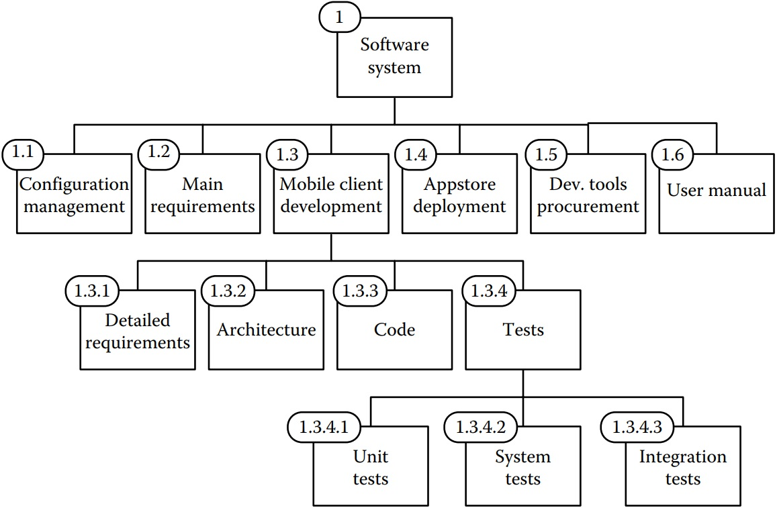

Slide 26
The Project Feasibility Document -> Deciding the Work -> WBS

Slide 27
WBS Decomposition Styles
Different decomposition styles allow one to build a WBS.
In a product-oriented WBS, the decomposition proceeds by identifying the items that must be developed to build deliverables.
In a process-oriented WBS, the decomposition proceeds by taking into account the activities that are necessary to carry out the project. One advantage of the process-oriented decomposition is that it can include activities, such as management, which are not directly related to the development of a product, but which are still necessary in a project.
To get the best of both worlds, one can use a hybrid WBS. A hybrid WBS contains both process- and product-oriented nodes.

Slide 28
WBS Dictionary
A WBS dictionary helps to annotate each element of the WBS with more detailed and structured information, such as
Title and item number, to connect the description to an element of the WBS
Detailed description of the element, including, for instance, quantities, relevant associated work, and contractual items, where applicable…

Slide 29
WBS Construction Methodologies
WBSs can be built top-down, bottom-up, or by analogy.
In the top-down approach, the construction of the WBS proceeds from the top level down to the leaves. It is usually best suited for projects that are well known or whose structure is clear.
In the bottom-up approach, the process proceeds in the opposite way. First, the leaves of the WBS are identified and then these are grouped in homogeneous items, thus giving structure to the WBS. It is best suited for projects that are new for a company.
The third option, construction by analogy, starts from an existing WBS, which is adapted and customized for the project at hand. It can be very effective when an organization standardizes the structure of its projects.

Slide 31


